Slide 1
Final Project Presentation
LIN TANG

Slide 2
Problem Statements
1. What are the trends of the polls over time (by month).
2. Build two different models (M1 and M2) to predict who is going to be the likely winner.
3. Using the given dataset to augment the election results with ground truth and perform 5-fold cross validation.
4. Based on 3, perform 5-fold cross validation and compute precision of M1 and M2. Does one of the model better than the other with 5% significance level?

Slide 3
Solution Approach 1
Calculate the mean value of adjpoll by month
Use ggplot to present visualization.

Slide 4
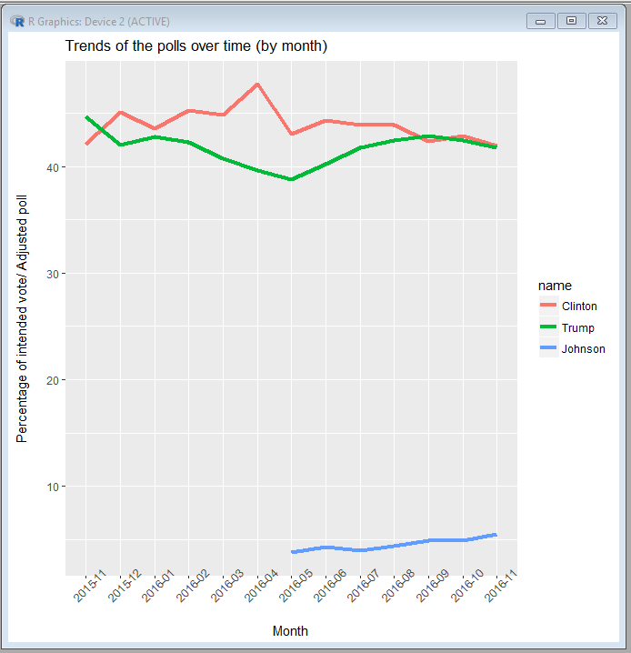
Result 1

Slide 5
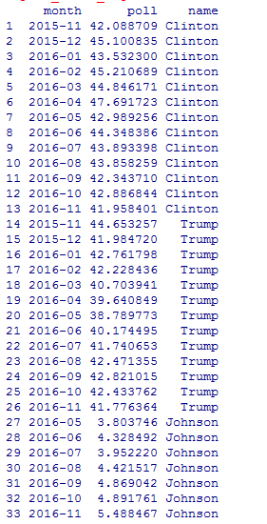
Result 1

Slide 6
Solution Approach 2
Do not consider Johnson and Mcmullin
Model: Random Forest and Logistic Regression
Outcome is a binary value
First encode 1 if Clinton is the winner, and 0 if Trump is the winner. Thus, we have a binary outcome.
Predictors: Poll_wt, Grade, Population, Samplesize, diffdays, collecteddays

Slide 7
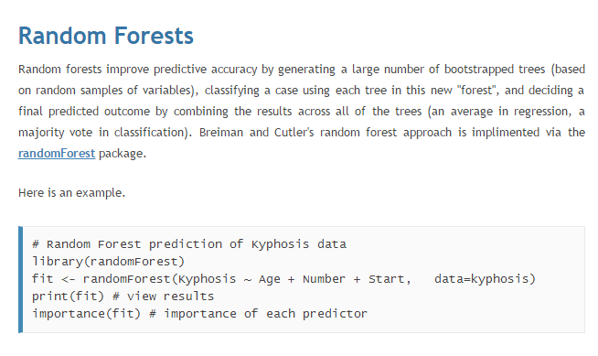
Solution Approach 2

Slide 8
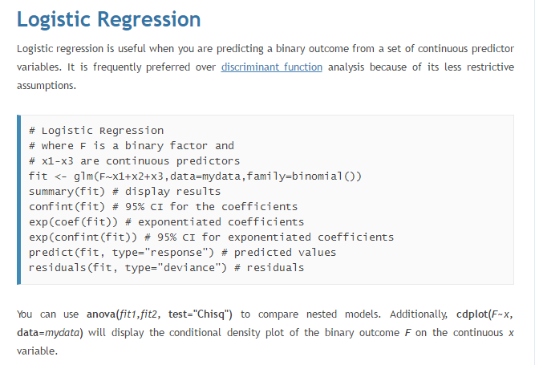
Solution Approach 2

Slide 9
Solution Approach 2
The predictor diffdays is the days between startdate and enddate.
The predictor collecteddays is the days from the beginning day, because we can see time has effect on the votes (The later days’ poll weight are higher than the old days’ poll weight. Many of the older surveys have a poll weight of pretty much zero, meaning they are not being used at all in estimating current predictions). Trump seems has a rising trend in the later days.

Slide 10
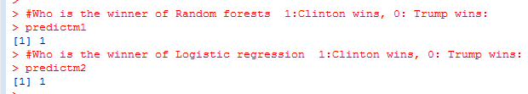
Result 2
Both of these two models predict Clinton is the winner.

Slide 11
Solution Approach 3
As we do not know the result of this election now, all of our data is training data, we actually do not have testing data. So we need to perform cross validation, using part of our training data as testing data (validation data)
Outcome: 1 or 0

Slide 12
Solution Approach 3
Follow the following steps to perform the 5-fold cross validation:
Split the training data set into equally 5-folds
Use one of the folds as validation data and all of the other 4 folds as training data
Train our two models on the training data and test on the validation data, record the results
Combine all the results into one result and compare it with the true outcome (outcome field in whole data set) and do it for two models.
Compute the precisions.

Slide 13


Result 3

Slide 14






Solution Approach 4
Precision:
Error rate:
Accuracy:
Recall
T value

Slide 15

Solution Approach 4
As we mentions in problem 3, we record all result of every fold, here is the five confusion matrix tables of two models:
We use the function to print matrix for every loop. The Odd number table is for model 1, the even number of table is for model two.
Then we use 00 as TP, 10 as FP, 01 as FN, 11 as TN

Slide 16
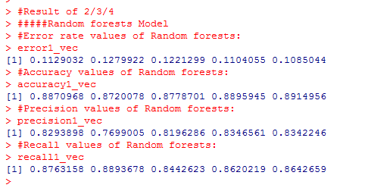
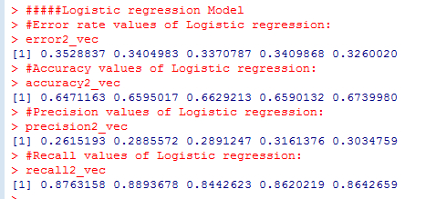


Result 4

Slide 17
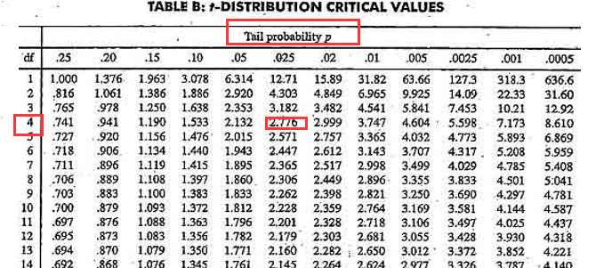
Result 4
We want to see does one of the model better than the other with 5% significance level. The sig/2 = 0.025, and the df = 4. And our t value is -47.52 < -2.776. Then our value of t lies in the rejection region, within the distribution’s tails. This means that we can reject the null hypothesis that the means of M1 and M2 are the same and conclude that there is a statistically significant difference between the two models. So, we go back to look at the precision values, error rate values and accuracy values, Model 1 have a higher precision and lower error rate. So the Random Forest model is better than Logistic regression model.

Slide 18
Programming Environment
Software: RGui

Slide 19
Conclusion
How to use the functions which are already contained in R language
Decide which dataset is useful
Use the knowledge I learned in class in the real world
There should be a way to use more predictors to do the result analysis.

